Slide 1


De Anza College
Enrollment and Outcomes
Complete July 21, 2026

Slide 2

Our Programs

Slide 3
De Anza offers over 275 program options.
De Anza College:
Degree Program = 86
Associate Degree for Transfer = 24
Credit Certificate = 135
Noncredit Certificate = 30
Bachelor Degree = 1

Slide 4

About
Our
Students

Slide 5
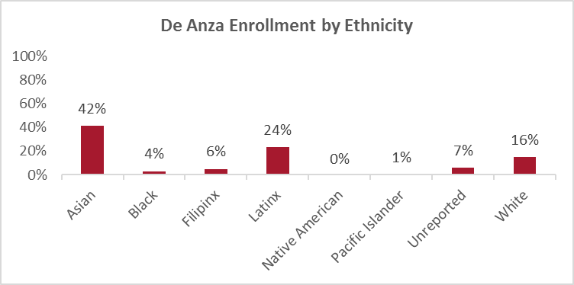
Students who identify as Asian or Latinx comprise 66% of De Anza’s enrollment.
All apportionment enrollments in 2025-26

Slide 6
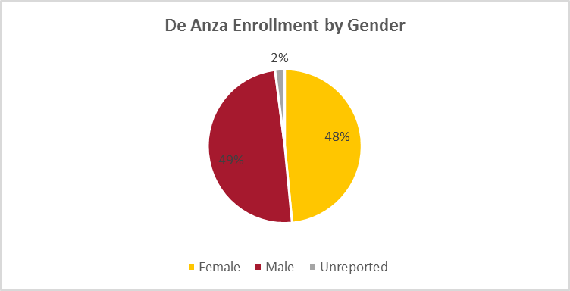
Enrollment by gender is about equally distributed between male and female students.
All apportionment enrollments in 2025-26.

Slide 7
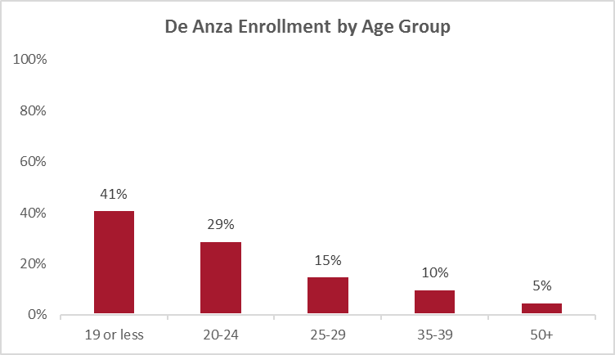
Enrollment of students under 25 years of age comprise 70% of total enrollment.
All apportionment enrollments in 2025-26.

Slide 8
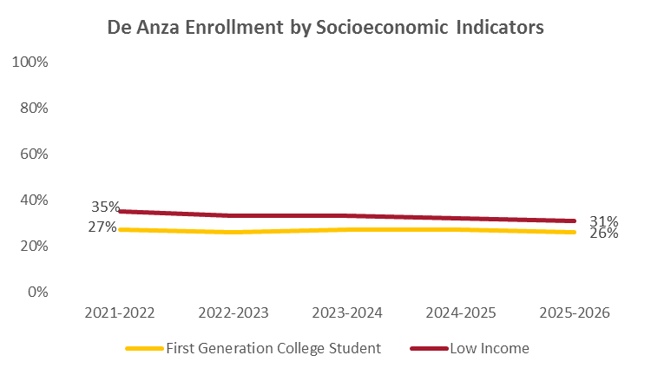
A third of students identify as low income while a quarter are first generation college students.
All apportionment enrollments. Low income is defined as a family of 4 at $50,000. First generation no parent or guardian has any college experience. PELL is often used as an indicator for low income. Indicators are not mutually exclusive.

Slide 9
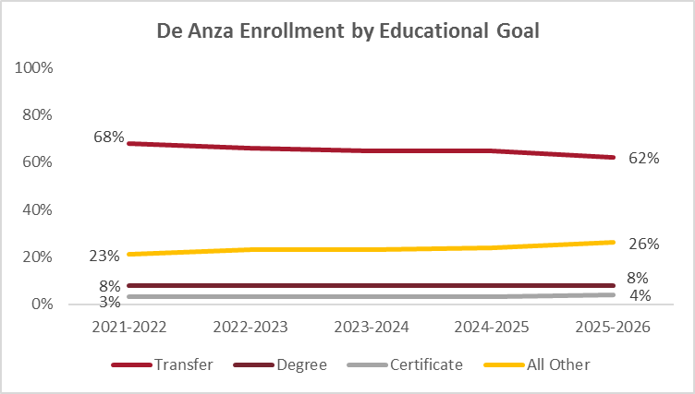
Over 60% of students declare a goal of transfer.
All apportionment enrollments. All other education goal includes career upskilling and personal enrichment.

Slide 10
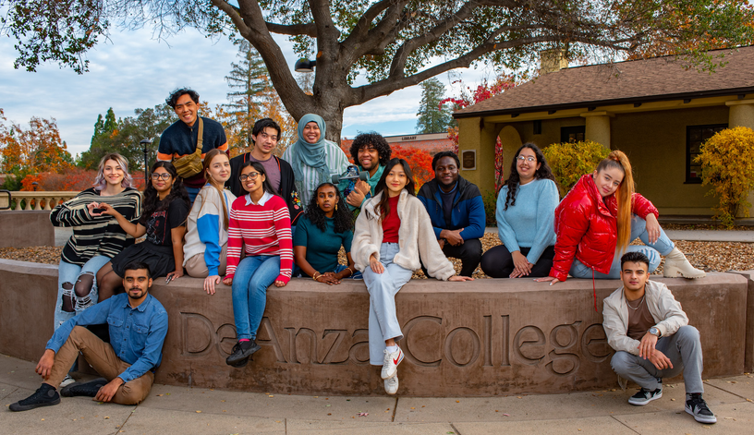
Enrollment Patterns by Service Area

Slide 11
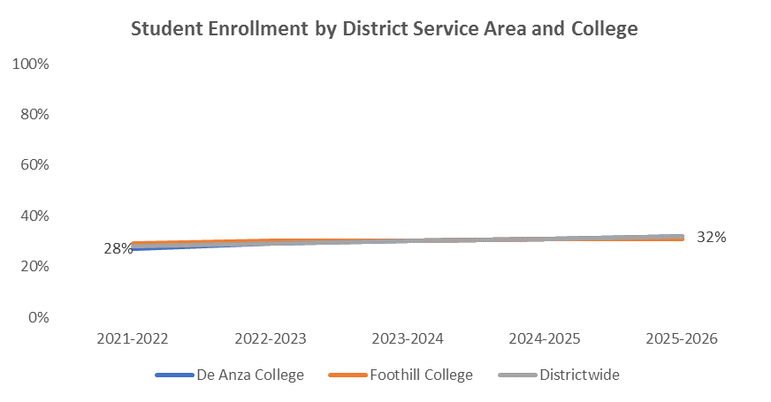
De Anza enrollment is comprised of 32% of students who reside within the district service area.
All apportionment enrollments. District Service Area : Cupertino, Sunnyvale, Santa Clara (part of), San Jose (part of), Saratoga (part of), Los Altos, LA Hills, Mt. View, Palo Alto, Stanford

Slide 12
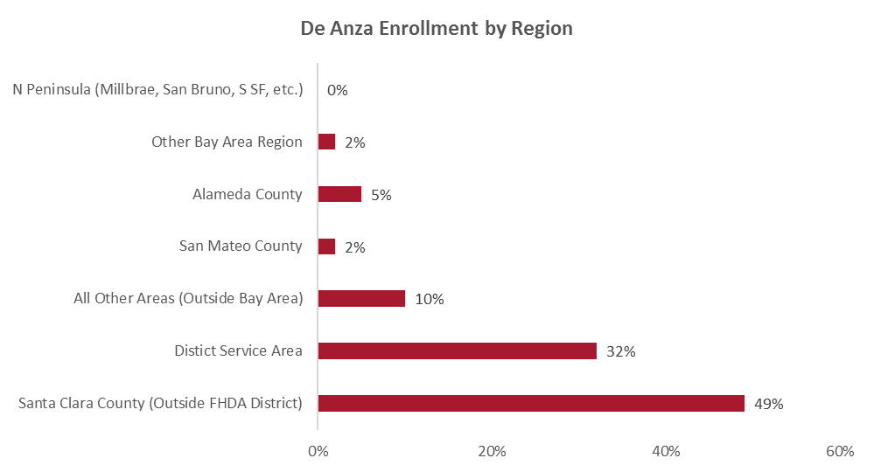
Half of De Anza’s enrollment outside the district service area is within Santa Clara County.
All apportionment enrollments in 2025-26. N’s represent student headcount.

Slide 13
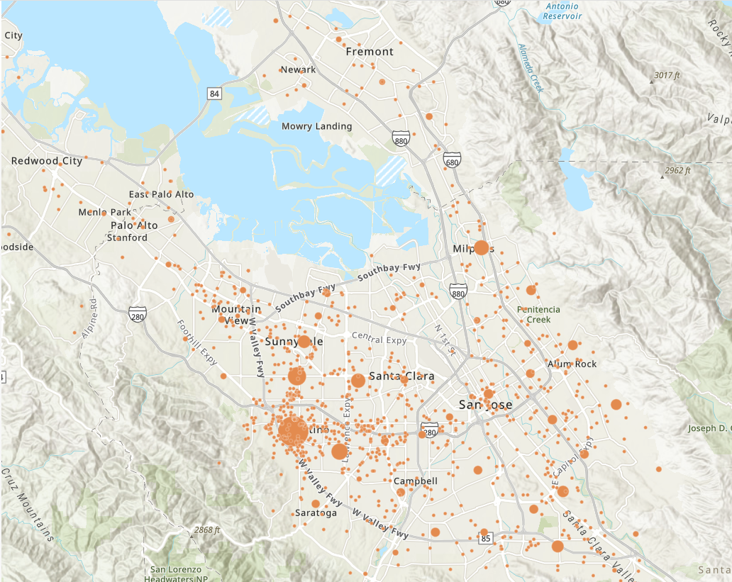
Student enrollment is concentrated across the south peninsula.
All apportionment enrollments in 2025-26.

Slide 14
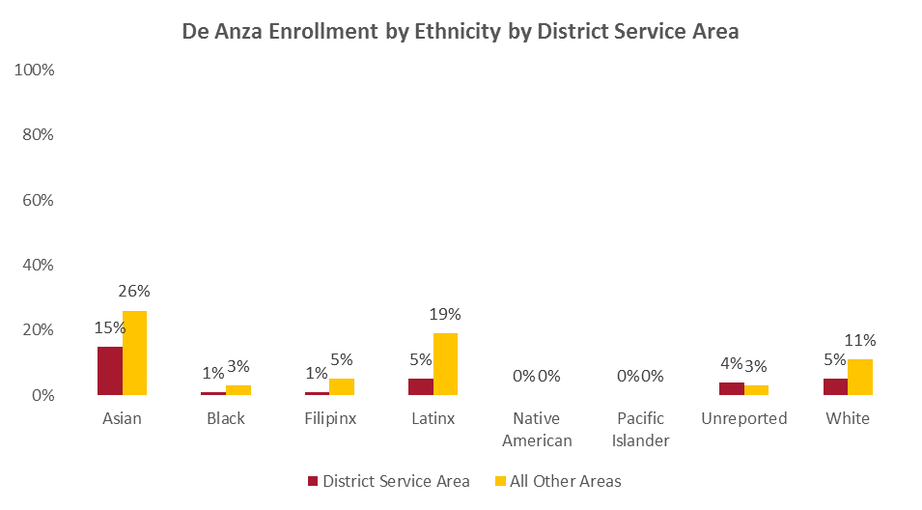
A greater proportion of students who identify as Asian, Black, Filipinx, Latinx and white reside outside the district service area than within.
All apportionment enrollments in 2025-26. District Service Area : Cupertino, Sunnyvale, Santa Clara (part of), San Jose (part of), Saratoga (part of), Los Altos, LA Hills, Mt. View, Palo Alto, Stanford

Slide 15
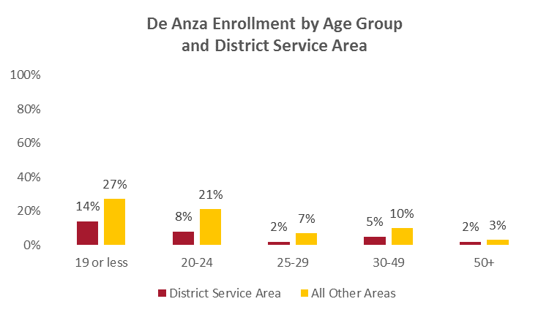
A larger proportion of our students under 24 years of age reside outside our district service area.
All apportionment enrollments in 2025-26. District Service Area : Cupertino, Sunnyvale, Santa Clara (part of), San Jose (part of), Saratoga (part of), Los Altos, LA Hills, Mt. View, Palo Alto, Stanford

Slide 16
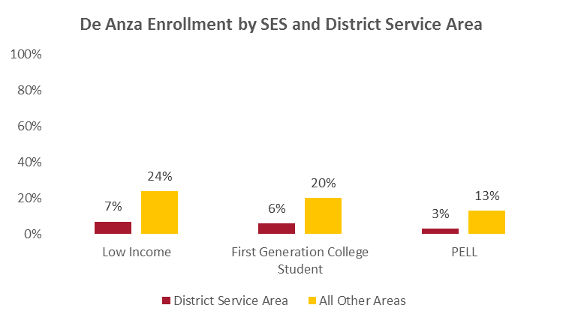
A higher rate of De Anza students who reside outside the district service area are low income, first gen and PELL recipients.
All apportionment enrollments in 2025-26. District Service Area : Cupertino, Sunnyvale, Santa Clara (part of), San Jose (part of), Saratoga (part of), Los Altos, LA Hills, Mt. View, Palo Alto, Stanford
Low income is defined as a family of 4 at $50,000. First generation no parent or guardian has any college experience. PELL is often used as an indicator for low income. Indicators are not mutually exclusive.

Slide 17
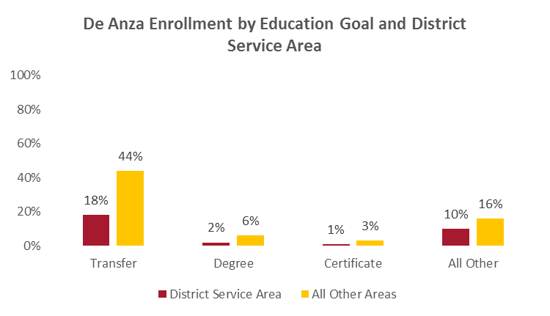
A larger proportion of De Anza students with a transfer goal reside outside the district service area than within.
All other education goals includes career upskilling and personal enrichment.
All apportionment enrollments in 2025-26. District Service Area : Cupertino, Sunnyvale, Santa Clara (part of), San Jose (part of), Saratoga (part of), Los Altos, LA Hills, Mt. View, Palo Alto, Stanford

Slide 18
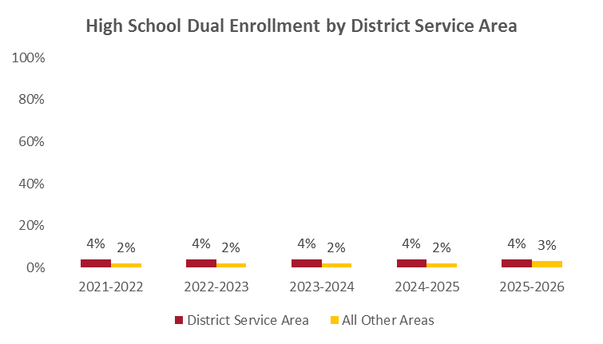
De Anza dual enrolled high school reside within the district service area at a higher rate.
Dual enrollment high schools includes: Cupertino, Fremont, Homestead, Lynbrook, Monta Vista, Gunn. All apportionment enrollments.

Slide 19

Enrollment Patterns by Modality

Slide 20
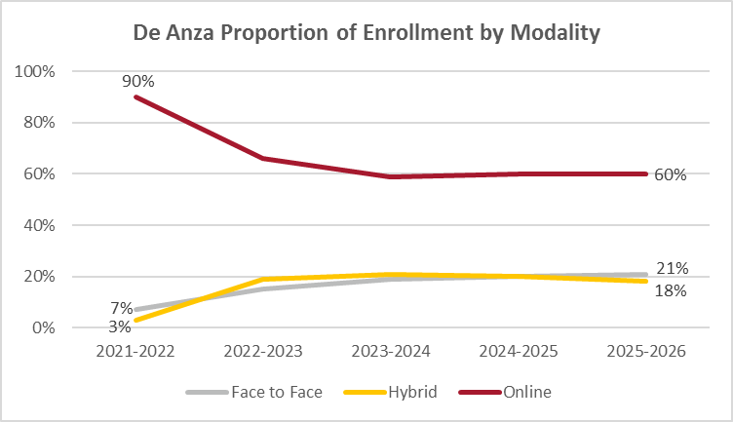
The proportion of enrollment in online courses has stabilized at 60% of total enrollments.
All apportionment enrollments.

Slide 21
Enrollment Patterns by CTE

Slide 22
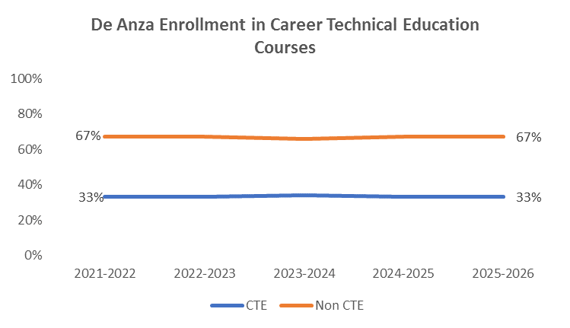
Career Technical Education (CTE) courses comprise a third of all enrollments districtwide.
All apportionment enrollments.

Slide 23
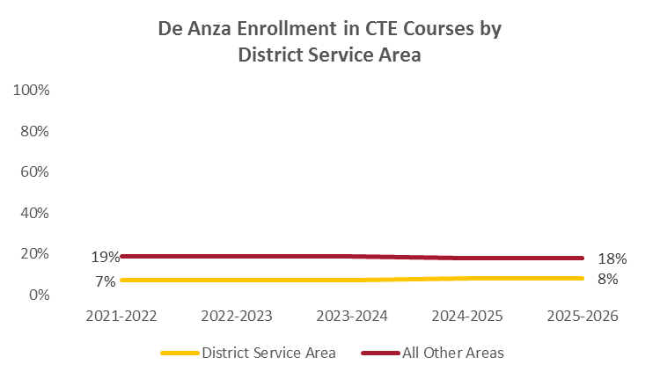
8% of CTE enrollment comes from within the district service area.
All apportionment enrollments in 2025-26. District Service Area : Cupertino, Sunnyvale, Santa Clara (part of), San Jose (part of), Saratoga (part of), Los Altos, LA Hills, Mt. View, Palo Alto, Stanford

Slide 24

Student
Outcomes

Slide 25
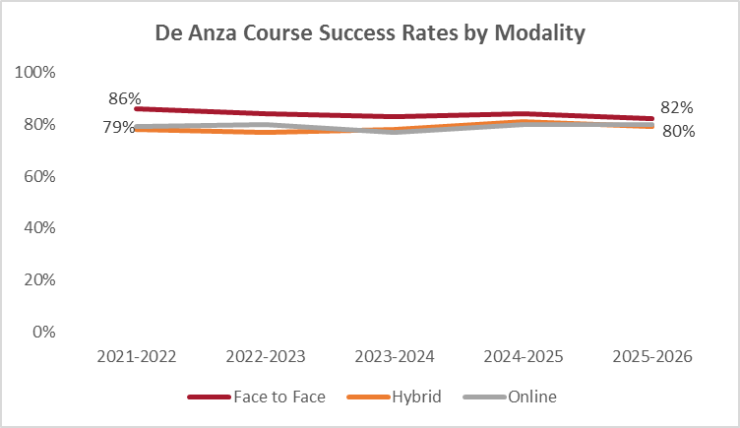
Gaps in course success have essentially closed between instructional modalities with success rates around 80%.
Credit sections. Enrollment reported for apportionment.

Slide 26
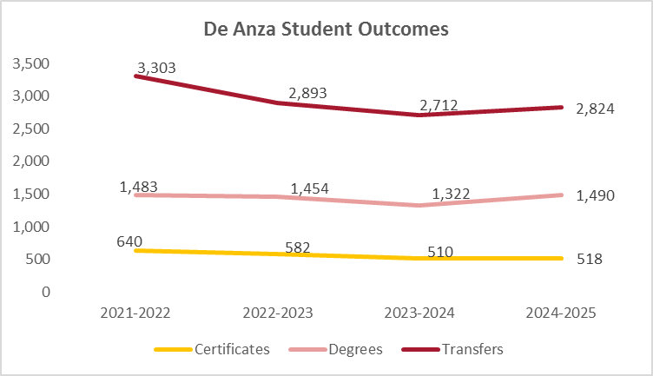
Transfer to four-year institutions drive student outcomes followed by associate degrees.

Slide 27
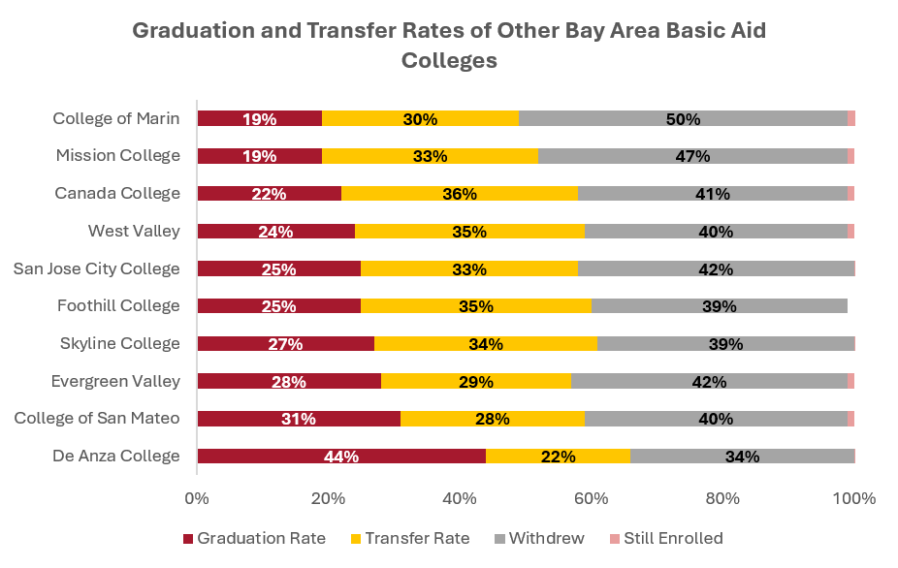
In comparison to other basic aid college completion rates, De Anza is at the top.
U.S. Department of Education Scorecard. Graduation and transfer rates are within 8 years of entry regardless of education goal.

Slide 28
Questions?

